Slide 1
STAT 350 Lab Central Limit Theorem
TA: Zhou Shen

Slide 2
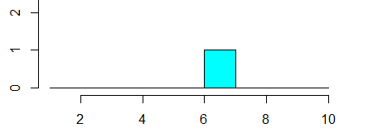
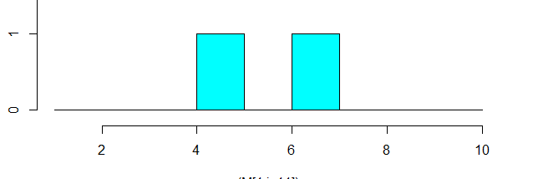
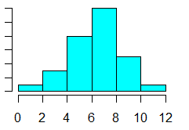
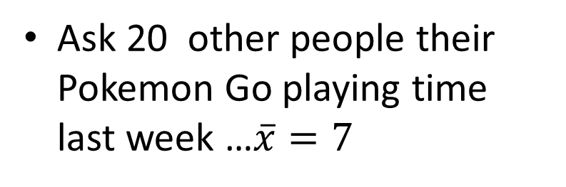
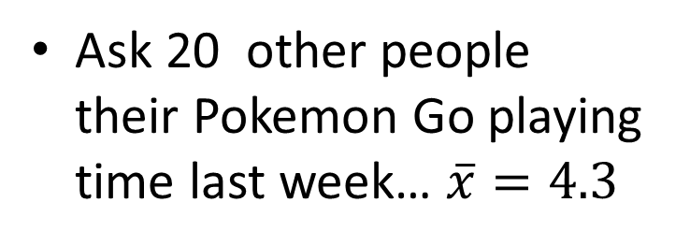
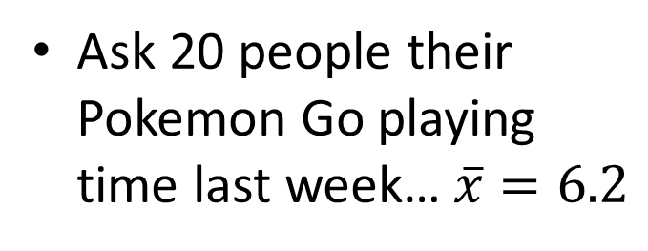
Consider this experiment…
Ask 20 people their Pokemon Go playing time last week…$\overline{x}=6.2$
Ask 20 other people their Pokemon Go playing time last week… $\overline{x}=4.3$
…
…
Ask 20 other people their Pokemon Go playing time last week …$\overline{x}=7$

Slide 3

Consider this experiment
Collect a bunch of samples of data
Calculate sample mean of the data for each sample
We could make a histogram of the sample means
HISTOGRAM OF $\overline{X}$

Slide 4
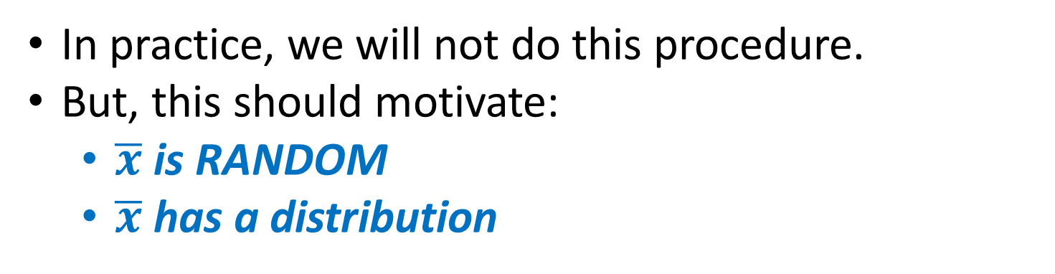
Sampling Distribution
In practice, we will not do this procedure.
But, this should motivate:
$\overline{x}$ is RANDOM
$\overline{x}$ has a distribution

Slide 5
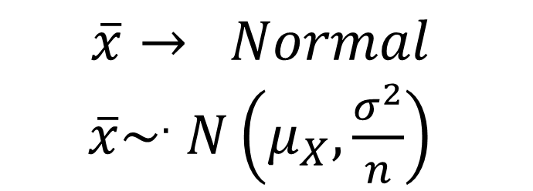
Central Limit Theorem
The sample mean of a large random sample will approach a NORMAL DISTRIBUTION*
$$\overline{x}→ Normal$$
$\overline{x}\sim ^{.} N\left(μ_{X},\frac{σ^{2}}{n}\right)$
*Technical condition: Distribution must have finite variance…

Slide 6
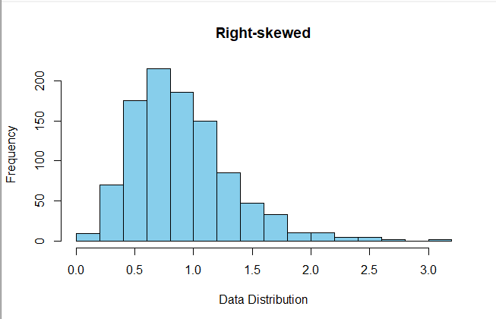
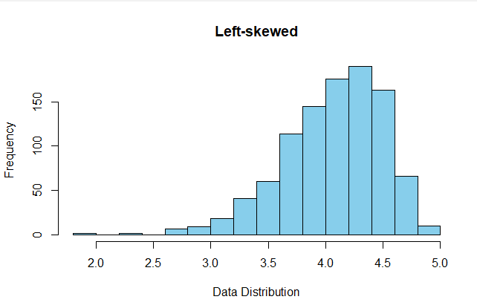
Central Limit Theorem
Notice: we did not specify the
distribution of the raw data.

Slide 7

This lab
n
4.66 | 3.86 | 2.43 | 1.38 | 0.70 | 3.05 | 0.01 | 6.54 | 8.56 | 3.47
9.40 | 9.57 | 4.23 | 5.38 | 4.76 | 8.25 | 0.04 | 1.06 | 9.98 | 5.85
9.32 | 0.99 | 5.63 | 3.77 | 1.14 | 1.73 | 4.72 | 1.76 | 9.36 | 4.27
6.40 | 1.65 | 5.59 | 2.53 | 5.28 | 4.38 | 7.79 | 8.47 | 7.25 | 5.48
3.85 | 1.00 | 5.05 | 6.42 | 6.10 | 8.65 | 1.88 | 5.42 | 0.01 | 4.26
2.13 | 3.46 | 3.92 | 7.35 | 1.21 | 4.84 | 5.95 | 3.50 | 7.51 | 4.43
5.39 | 5.08 | 3.64 | 2.12 | 5.15 | 3.26 | 7.81 | 1.86 | 1.87 | 4.02
2.92 | 9.90 | 8.11 | 4.53 | 2.13 | 0.33 | 5.59 | 5.63 | 2.36 | 4.61
4.28 | 7.04 | 8.70 | 6.93 | 9.55 | 3.69 | 9.17 | 6.77 | 5.16 | 6.81
3.60 | 2.16 | 6.41 | 4.56 | 8.62 | 5.46 | 3.89 | 9.39 | 7.62 | 5.74
1000
$$\overline{x}$$
The lab tutorial helps.

Slide 8
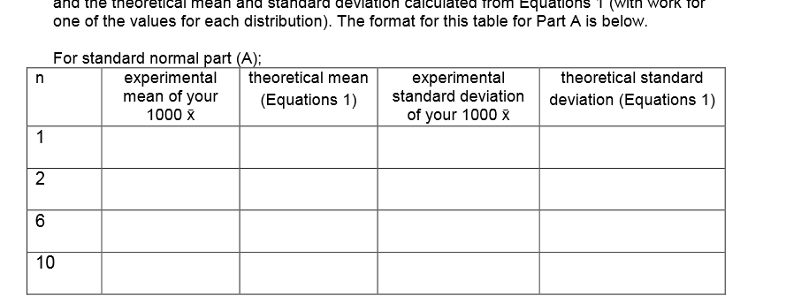

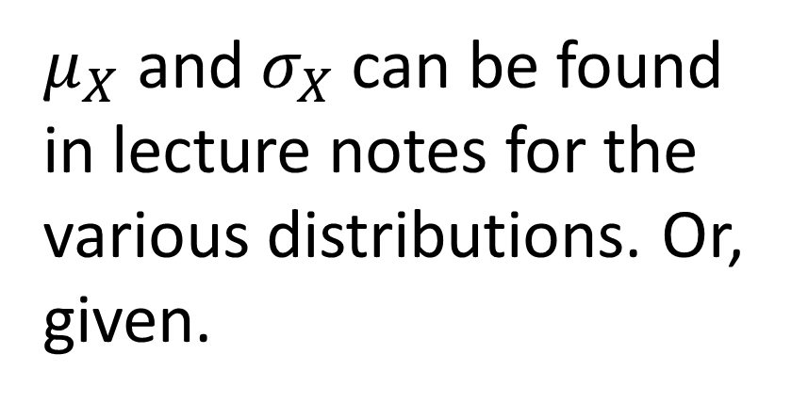
Theoretical versus experimental
$μ_{X}$ and $σ_{X}$ can be found in lecture notes for the various distributions. Or, given.

Slide 9
Group
1. Group Only
2. Groups of 3 to 4. Unless you have instructor permission
3. Same instructor
4. Clearly list names and sections
5. R and SAS can work together
Distribute the distributions, summarize together

Slide 10
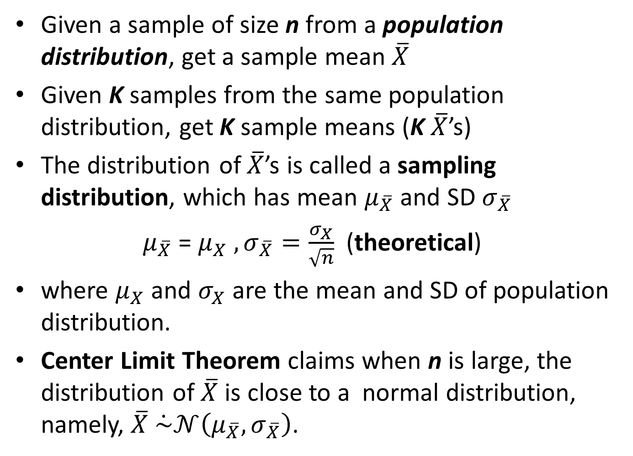
Summary
Given a sample of size n from a population distribution, get a sample mean $\overline{X}$
Given K samples from the same population distribution, get K sample means (K $\overline{X}$’s)
The distribution of $\overline{X}$’s is called a sampling distribution, which has mean $μ_{\overline{X}}$ and SD $σ_{\overline{X}}$
$μ_{\overline{X}}$ = $μ_{X} , σ_{\overline{X}}=\frac{σ_{X}}{\sqrt{n}}$ (theoretical)
where $μ_{X}$ and $σ_{X}$ are the mean and SD of population distribution.
Center Limit Theorem claims when n is large, the distribution of $\overline{X}$ is close to a normal distribution, namely, $\overline{X} \dot{\sim }𝒩\left(μ_{\overline{X}},σ_{\overline{X}}\right)$.

